Slide 1



MEDICAL HEALTHCARE
Your health, our priority. Compassionate care, innovative solutions—because your well-being is the heart of our mission.
VALEX

Slide 2


agenda
About Us
Our Vision
Our Mission
Website

Slide 3

About Us
we stand as your dedicated partners on the journey to optimal health. With a commitment to compassionate care and medical excellence, our team of experienced healthcare professionals is here to provide personalized solutions tailored to your well-being.

Slide 4


Our Vision
Empowering Health, Transforming Lives: Our vision at is to pioneer a healthier future by delivering exceptional medical care with compassion and innovation. We envision a community where every individual receives personalized, state-of-the-art healthcare, fostering well-being and vitality. Together, we strive to be a beacon of health, creating a lasting impact on lives and inspiring a paradigm shift in healthcare excellence.

Slide 5



Our Mission
Excellence in Patient Care:
Striving for medical excellence to ensure the highest quality of care for every patient.
Prioritizing the comfort, dignity, and well-being of those we serve.
Innovation in Healthcare Solutions:
Embracing cutting-edge technologies and medical advancements to provide state-of-the-art healthcare solutions.
Fostering a culture of continuous improvement and learning.

Slide 6


Website
Home page

Slide 7
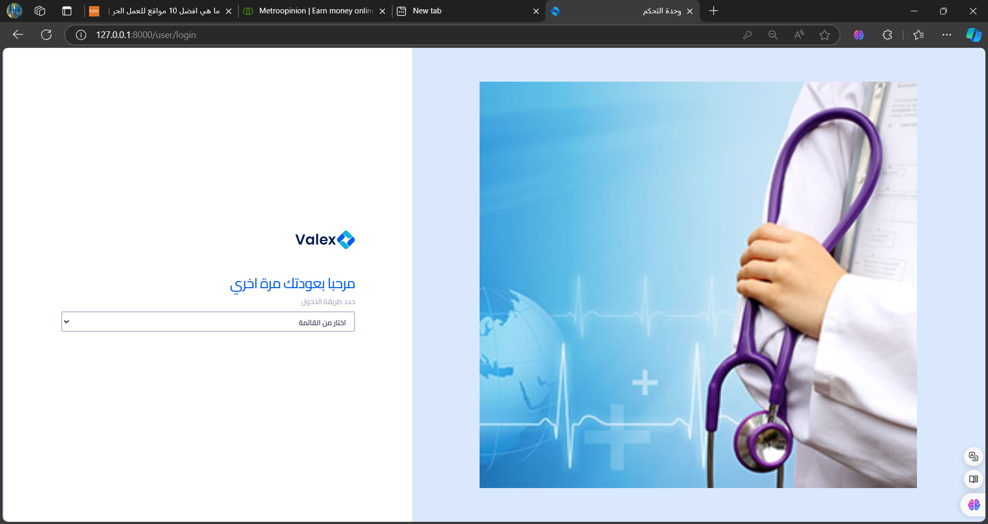
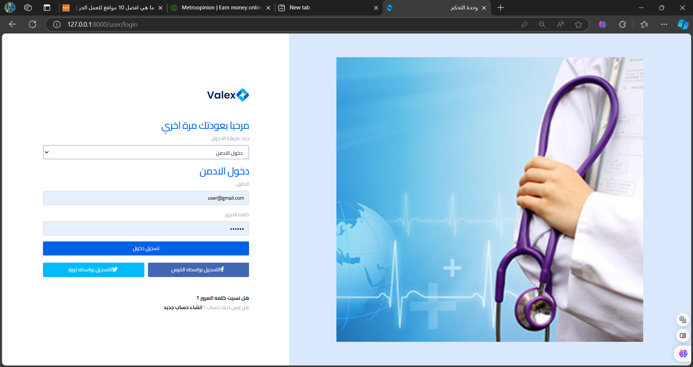
Log in Page

Slide 8
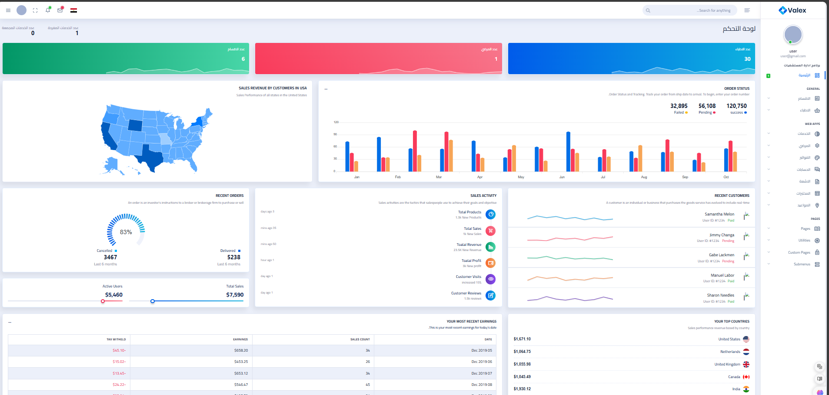
Dashboard Window
After click log in, Dashboard window will appear to you

Slide 9
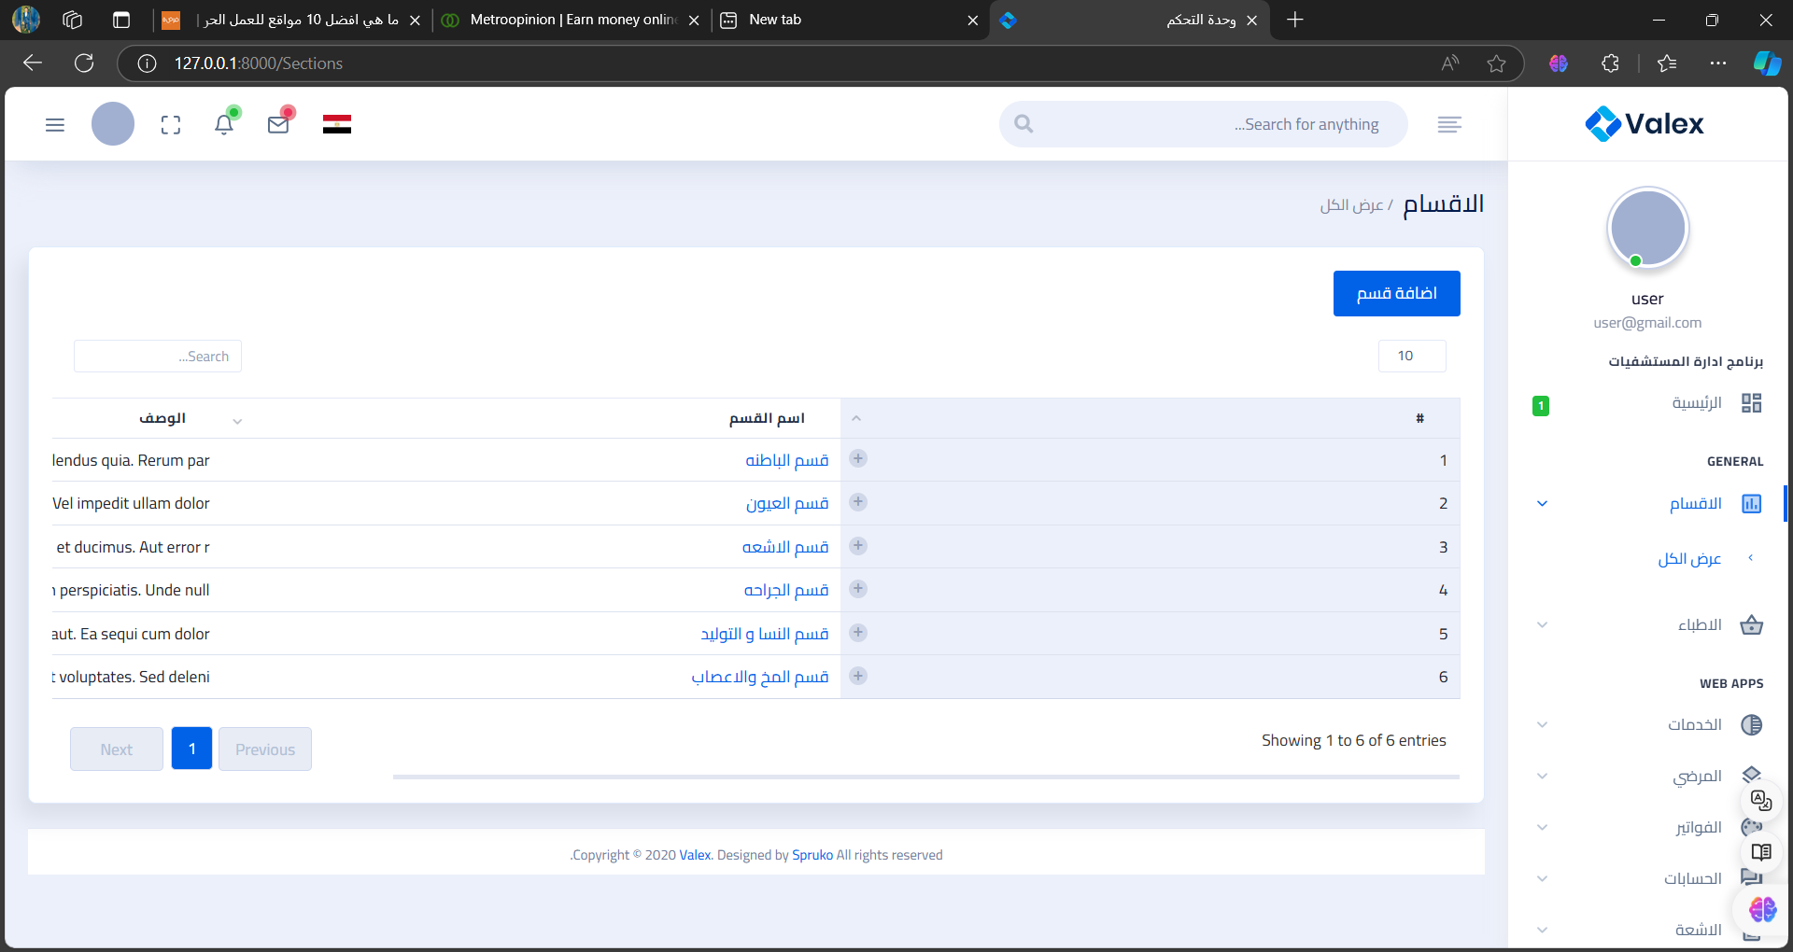
Departments Window

Slide 10
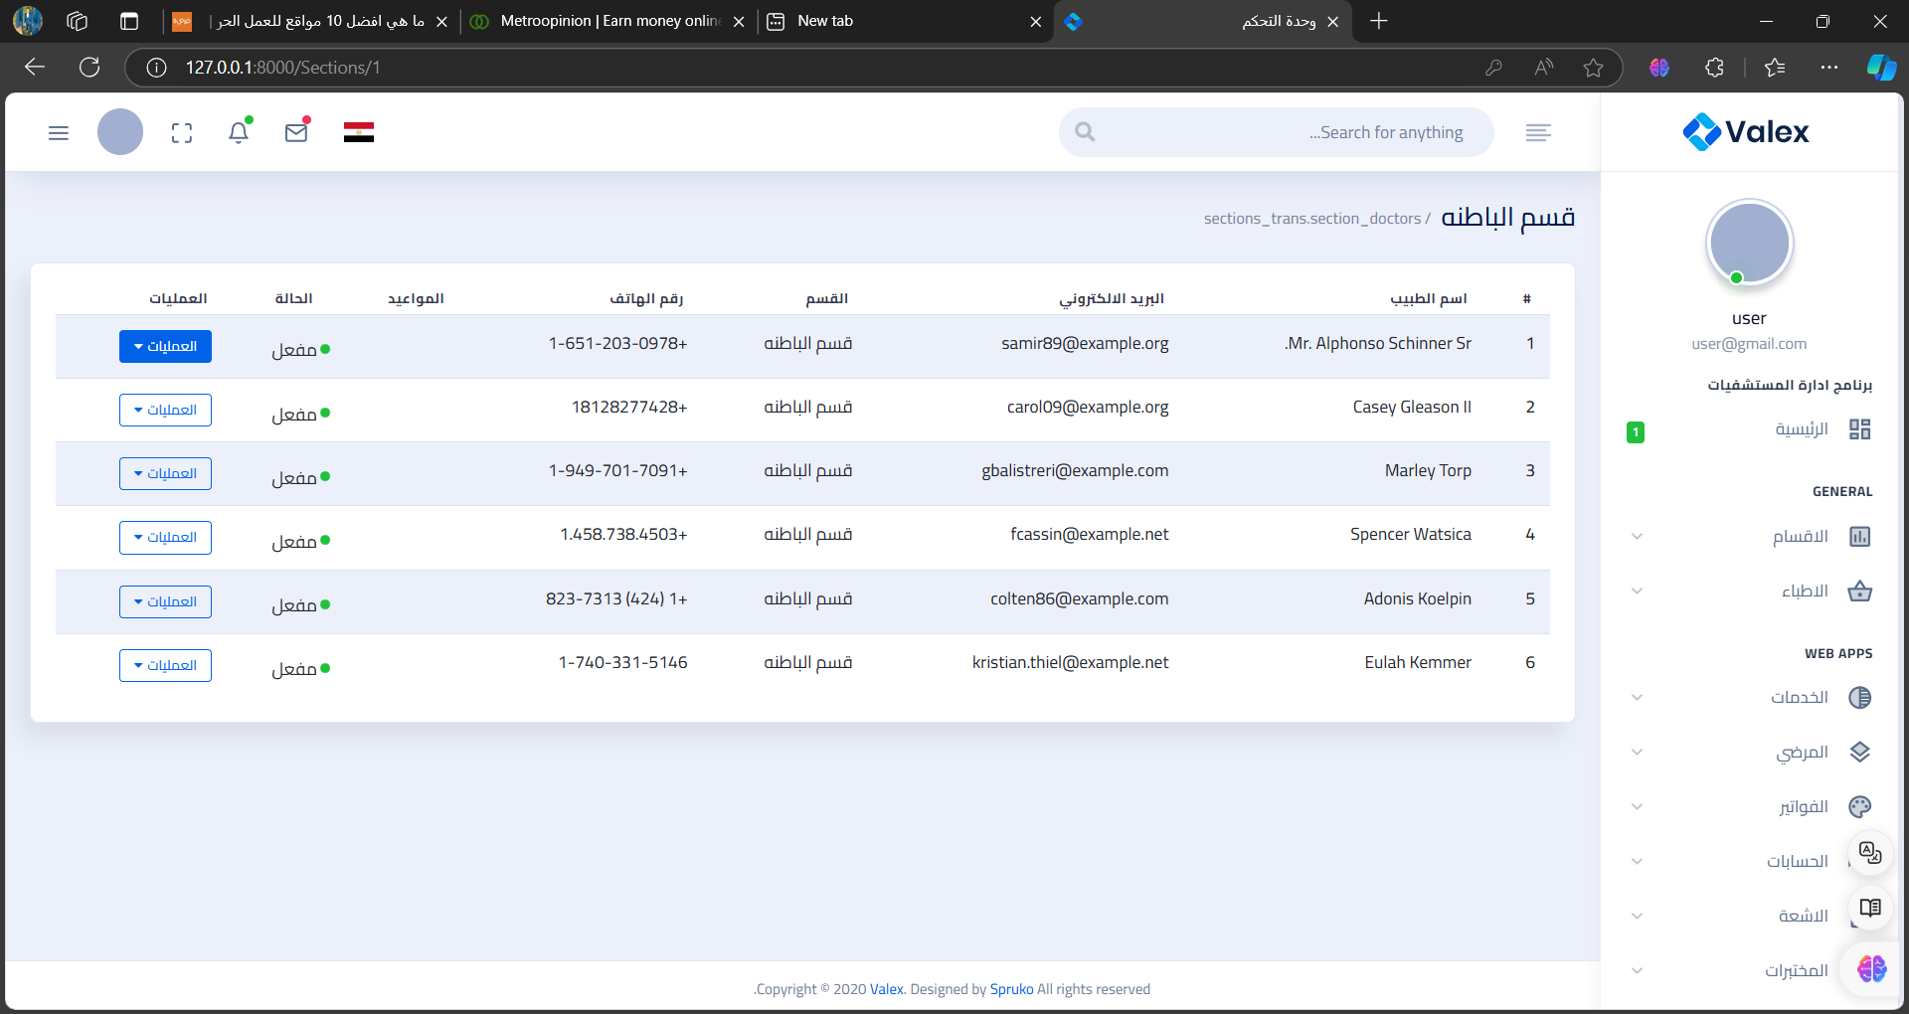
For example:
Department of Internal Medicine

Slide 11
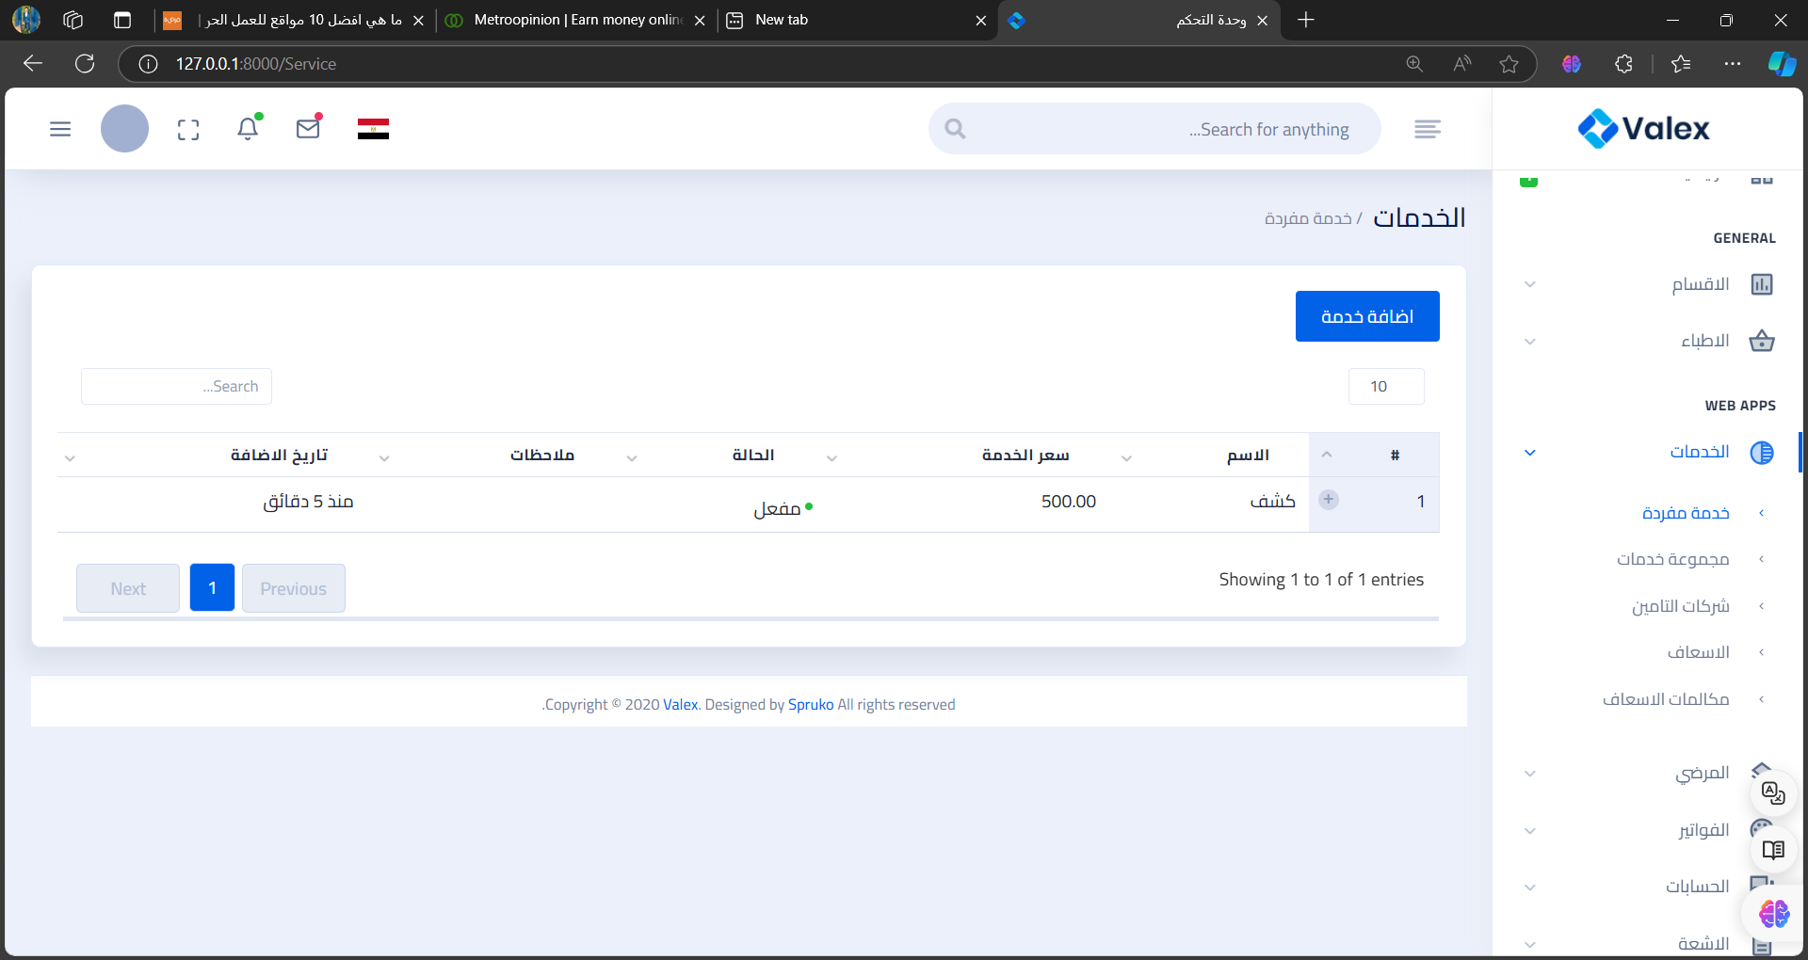
For example:
Services
Single Service

Slide 12
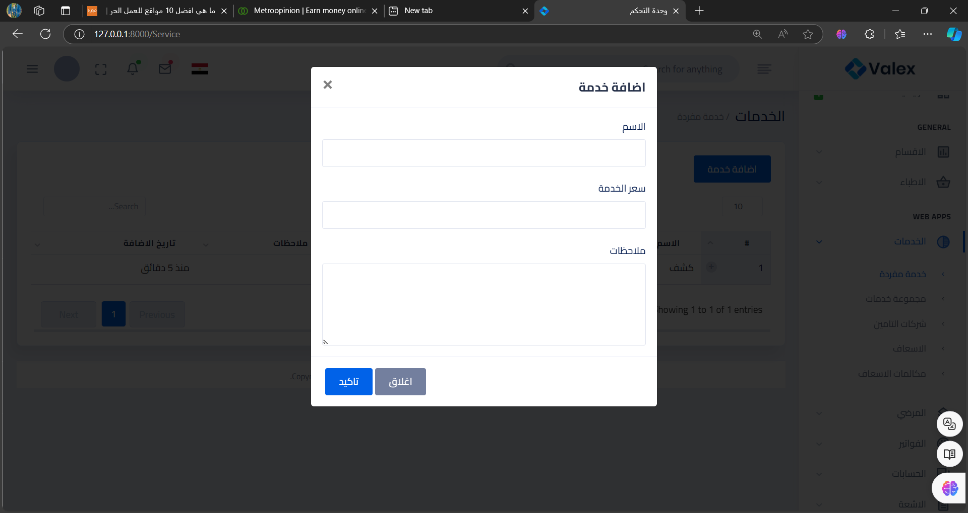
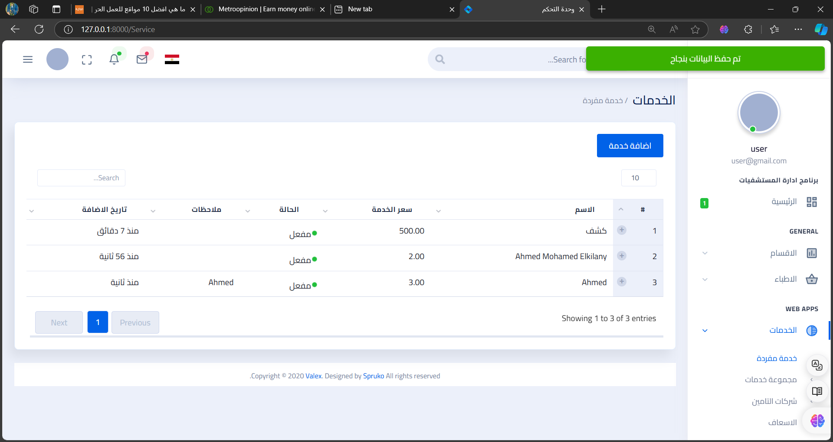
Add Service Window
If you want to add Service, you should click add service button , fill requirements then click ok.

Slide 13
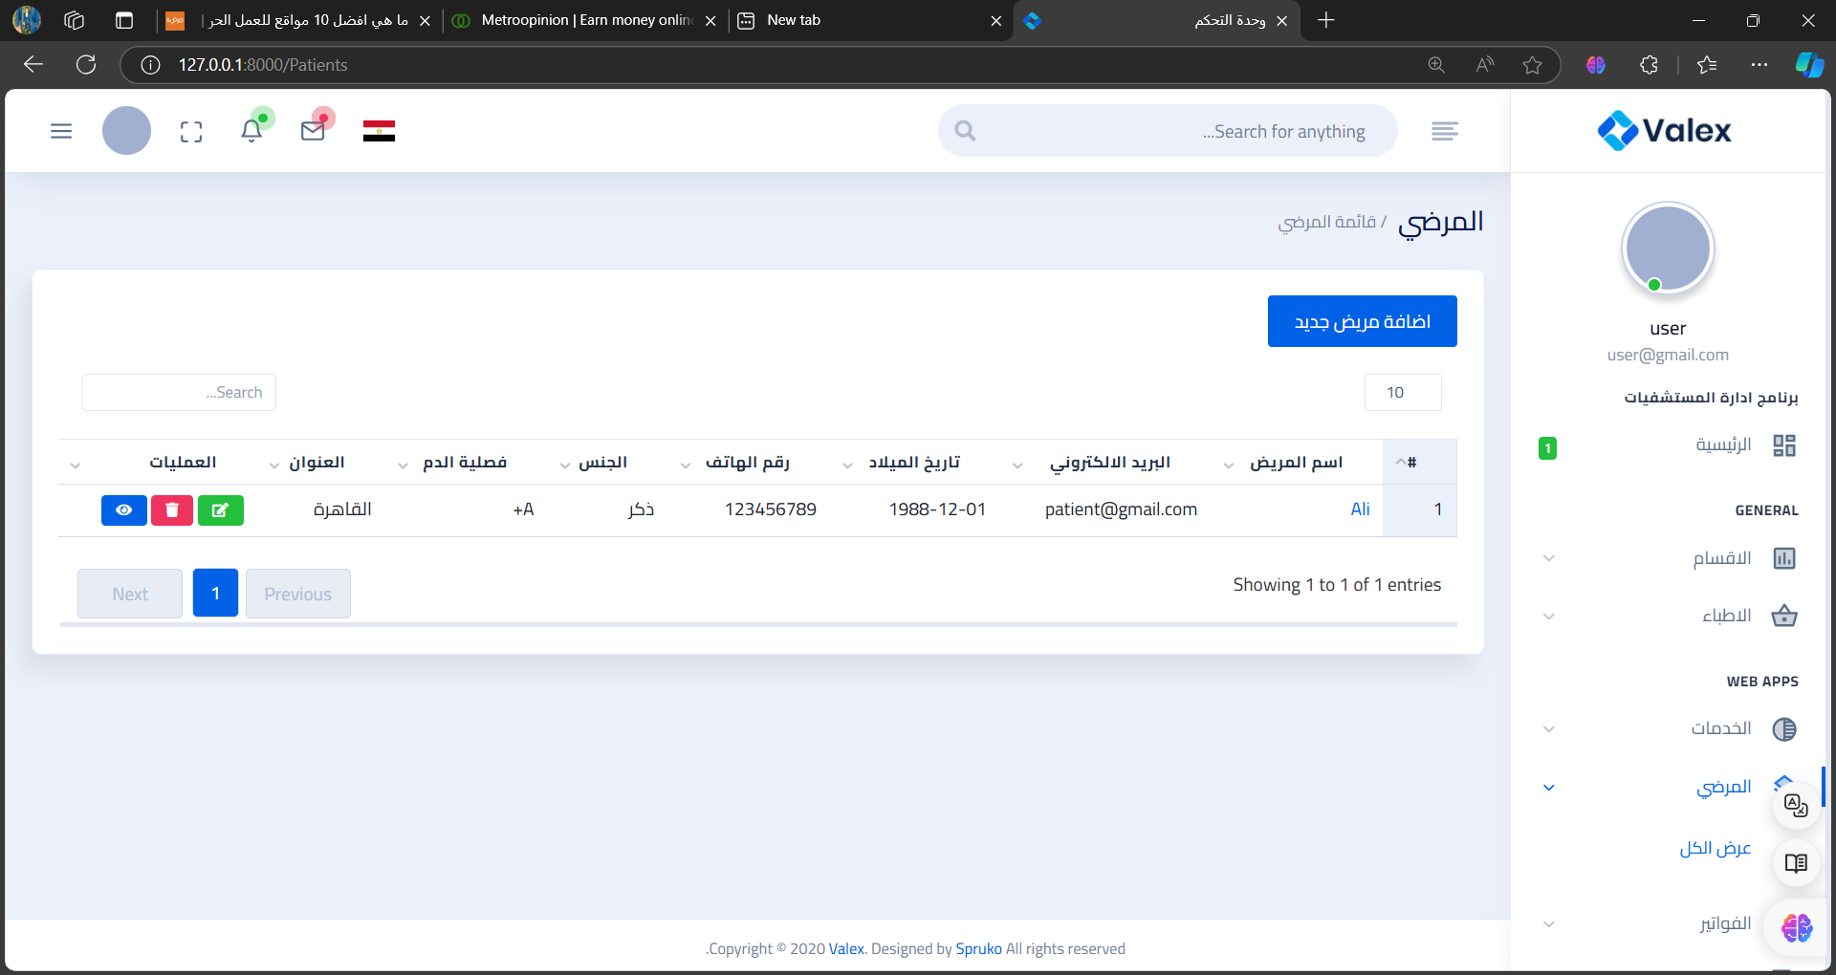
Patient Window

Slide 14
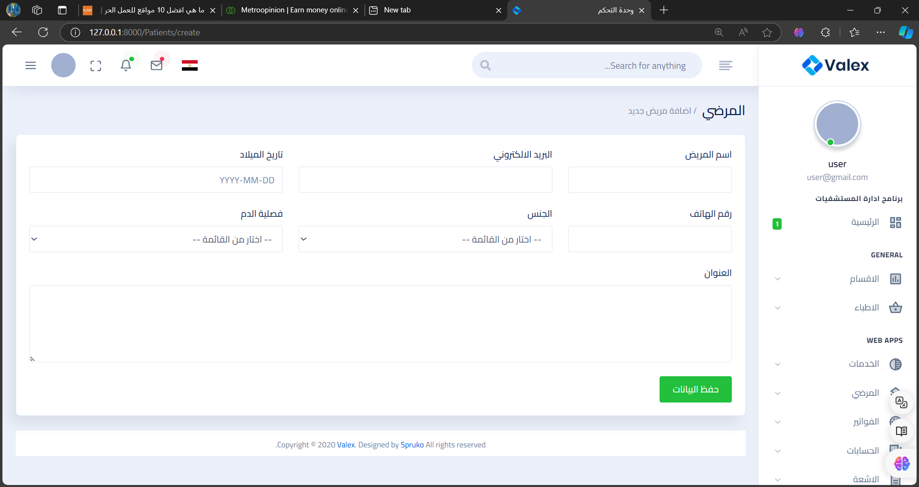
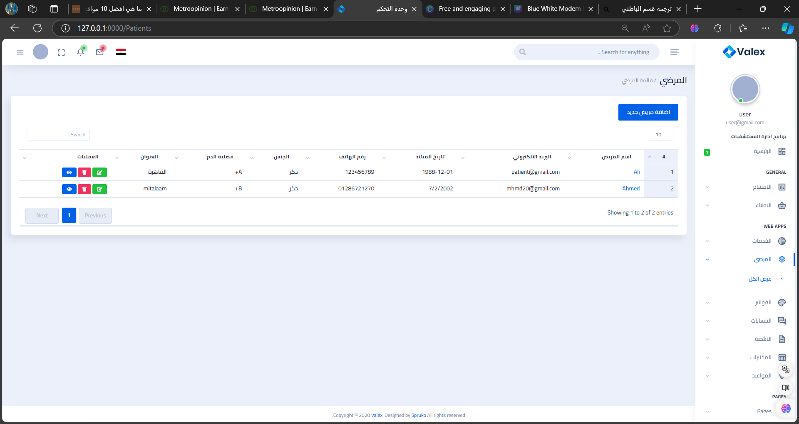
Add Patient Window
If you want to add patient, you should click add service button , fill requirements then click save.

Slide 15
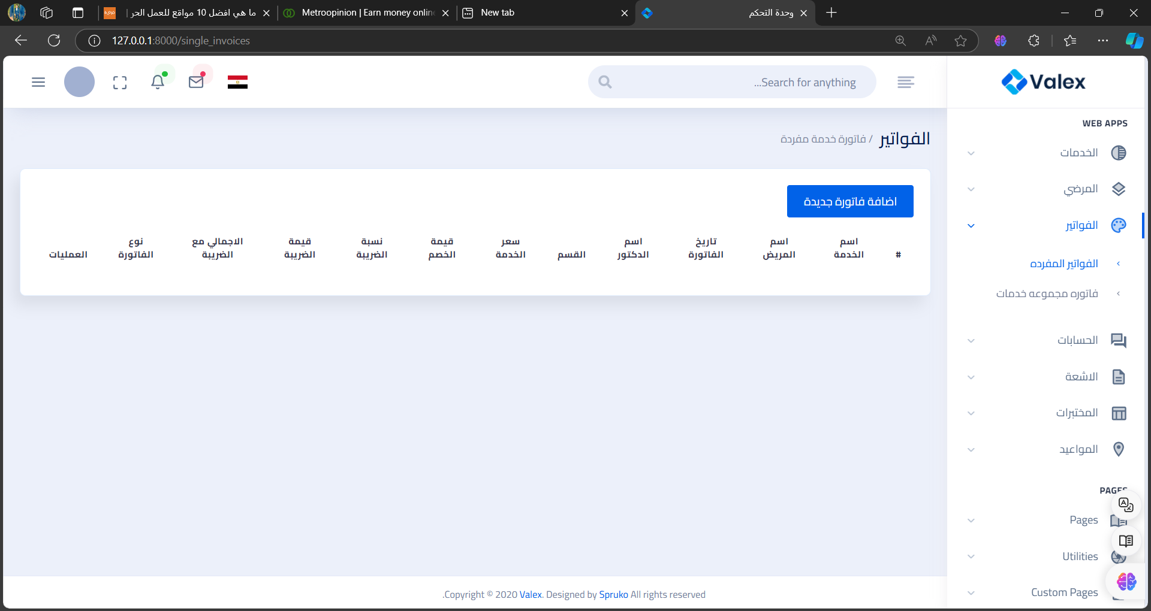
Bill Window

Slide 16
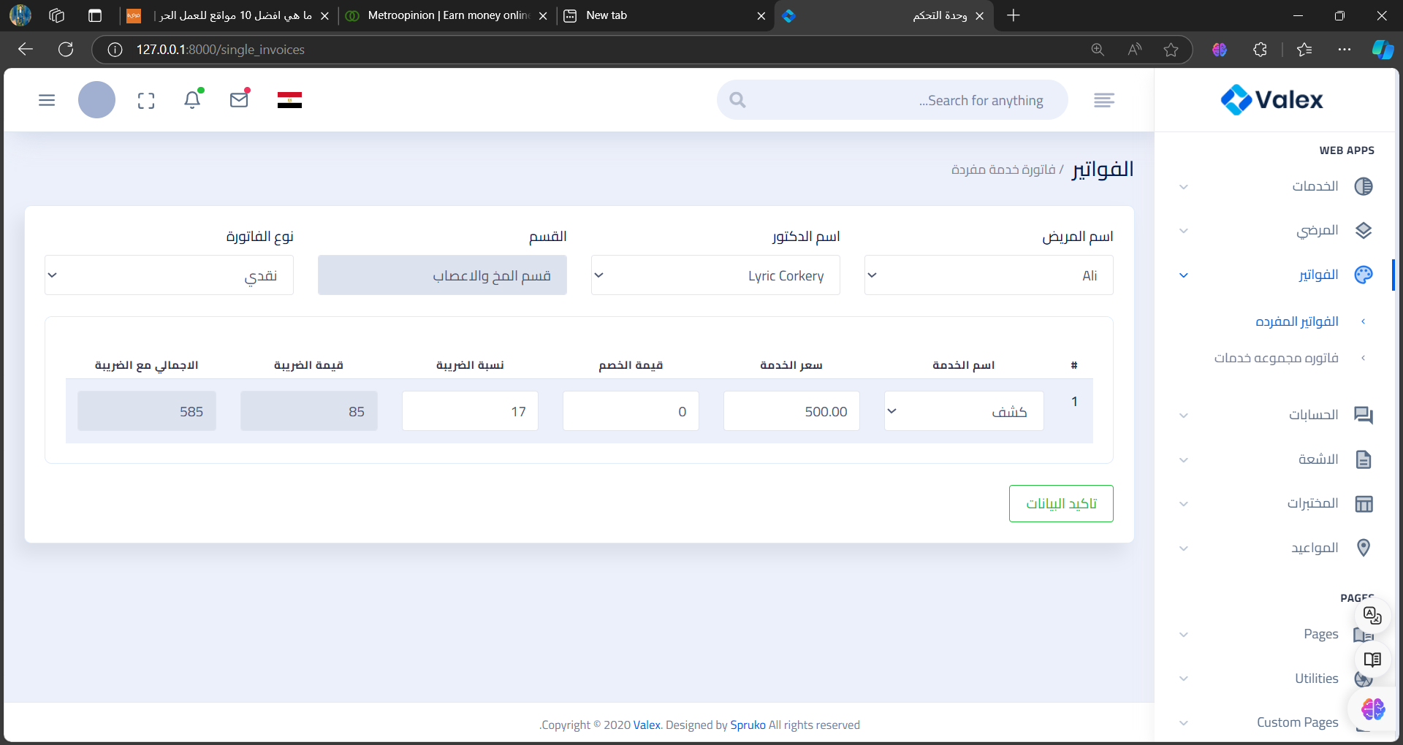
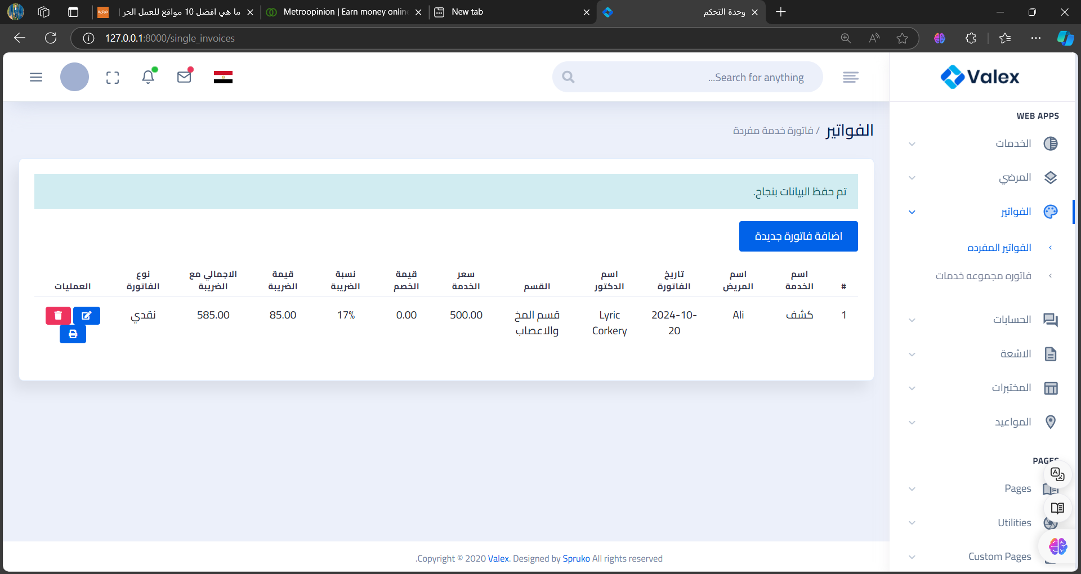
Add new bill
If you want to add bill, you should click add new bill button , fill requirements then click save.

Slide 17
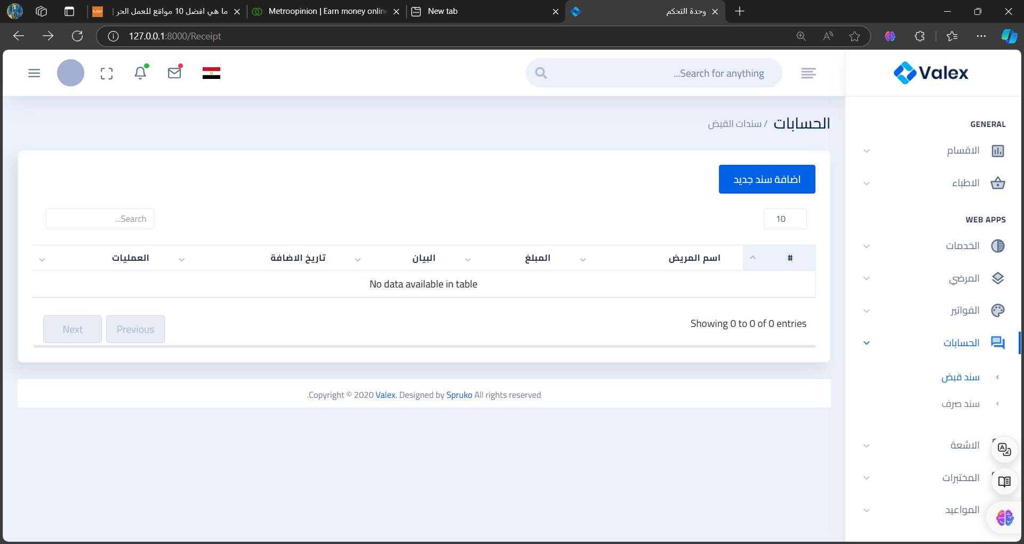
Accounts Window

Slide 18
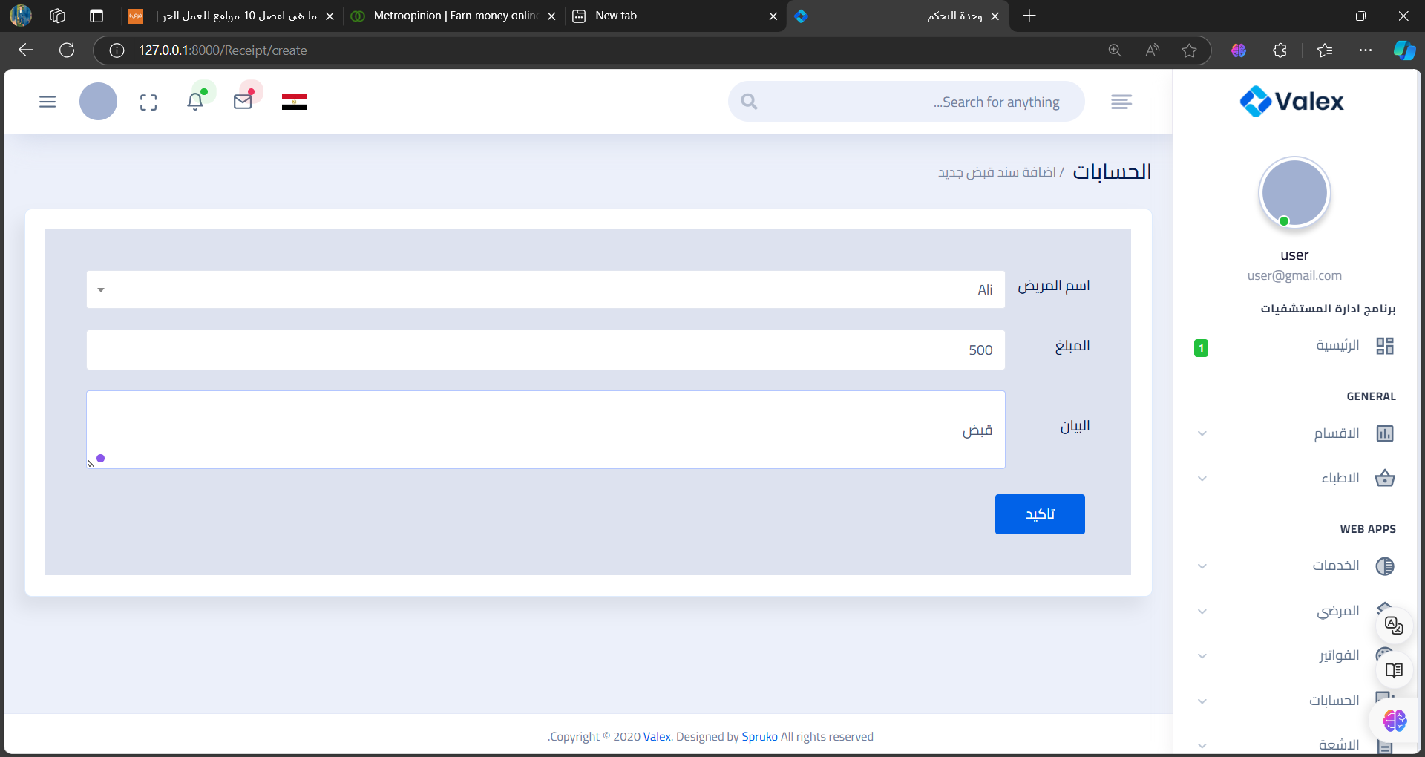
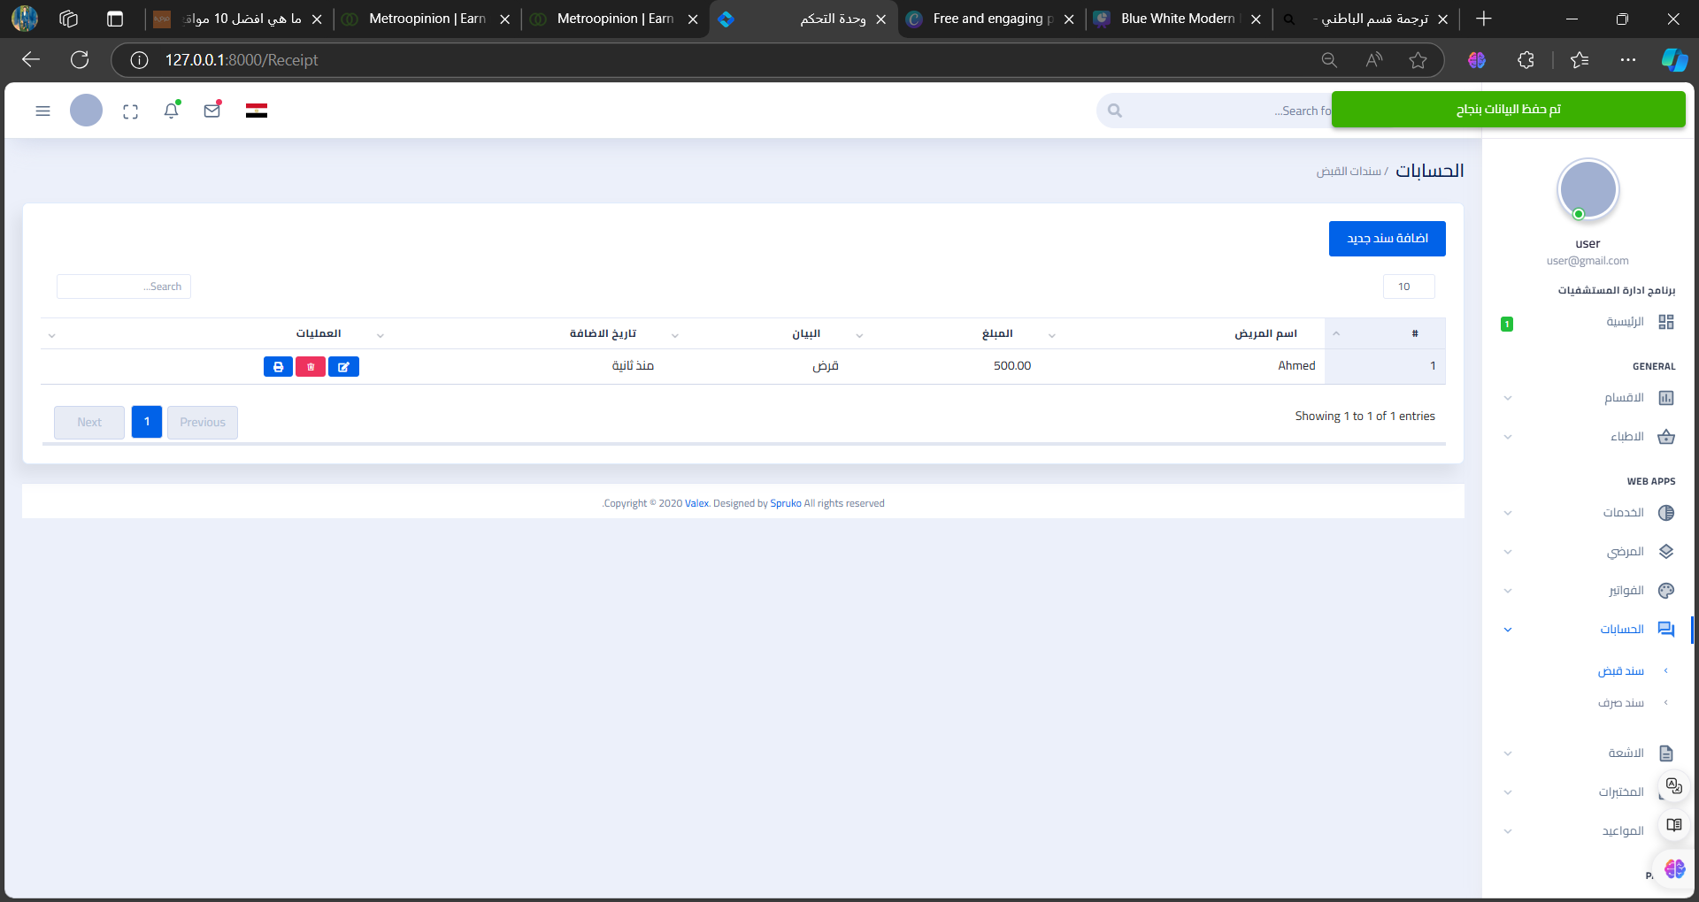
Add new account
If you want to add account, you should click add new account button , fill requirements then click save.

Slide 19
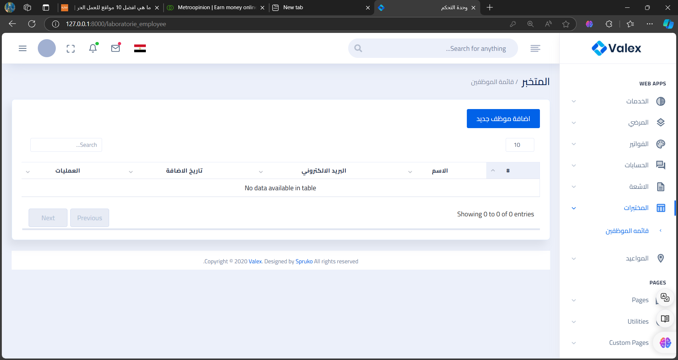
List of employees Window

Slide 20
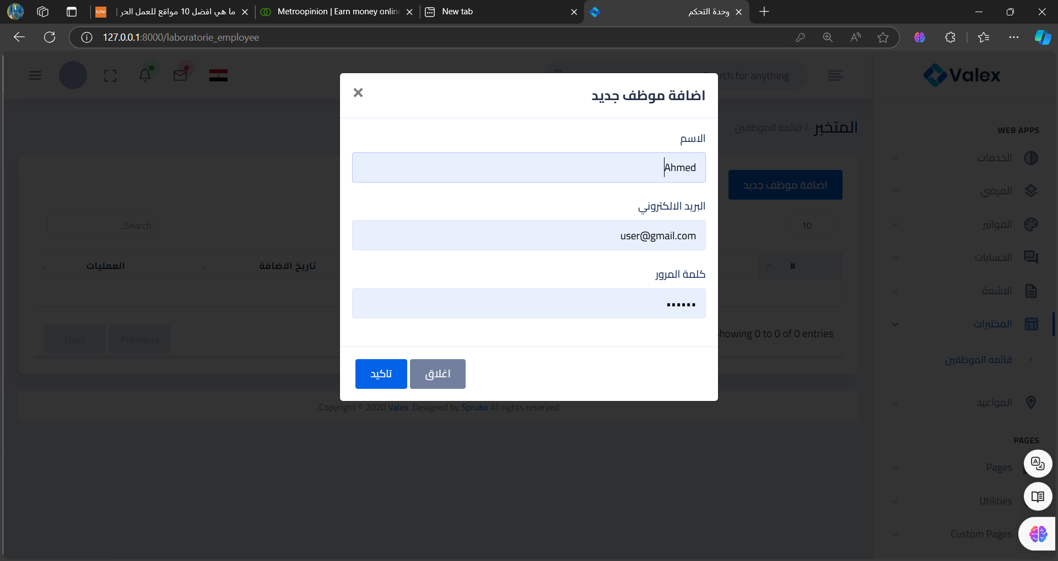
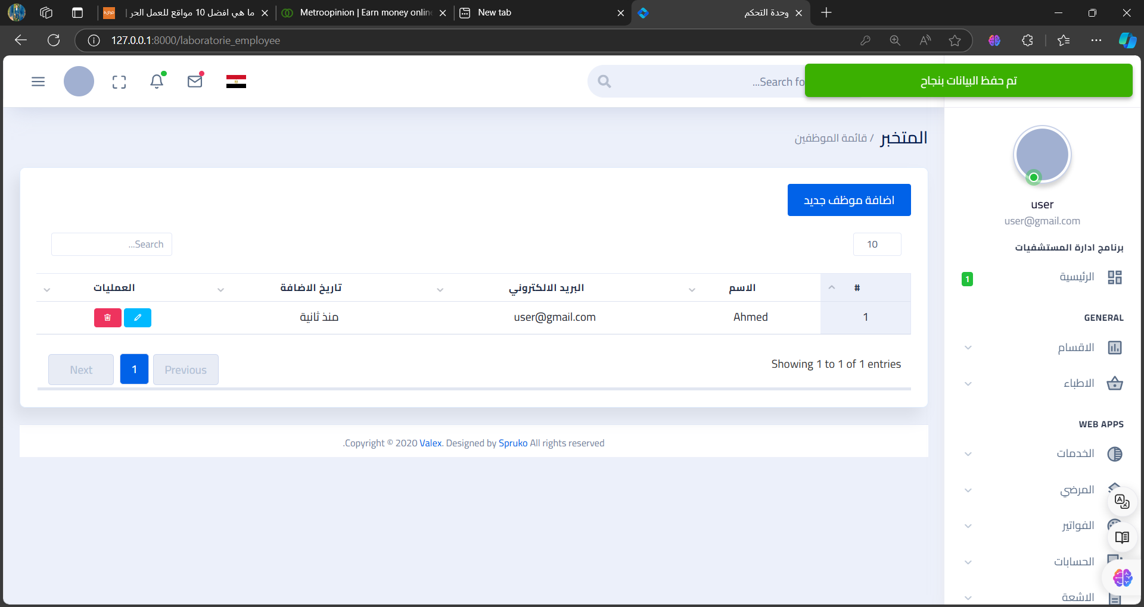
Add new employee
If you want to add employee, you should click add new employee button , fill requirements then click save.

Slide 21
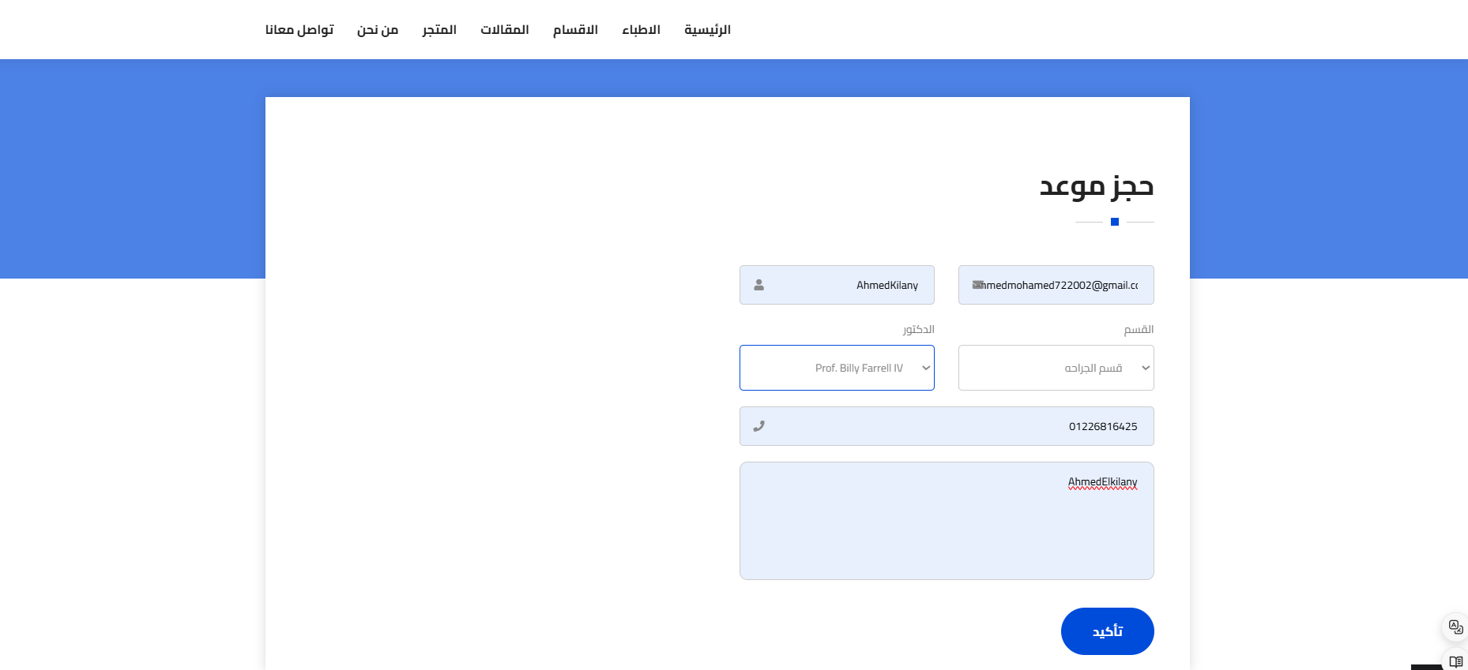
Book an appointment Window
If you want to book an appointment, you should fill requirements and click ok.

Slide 22
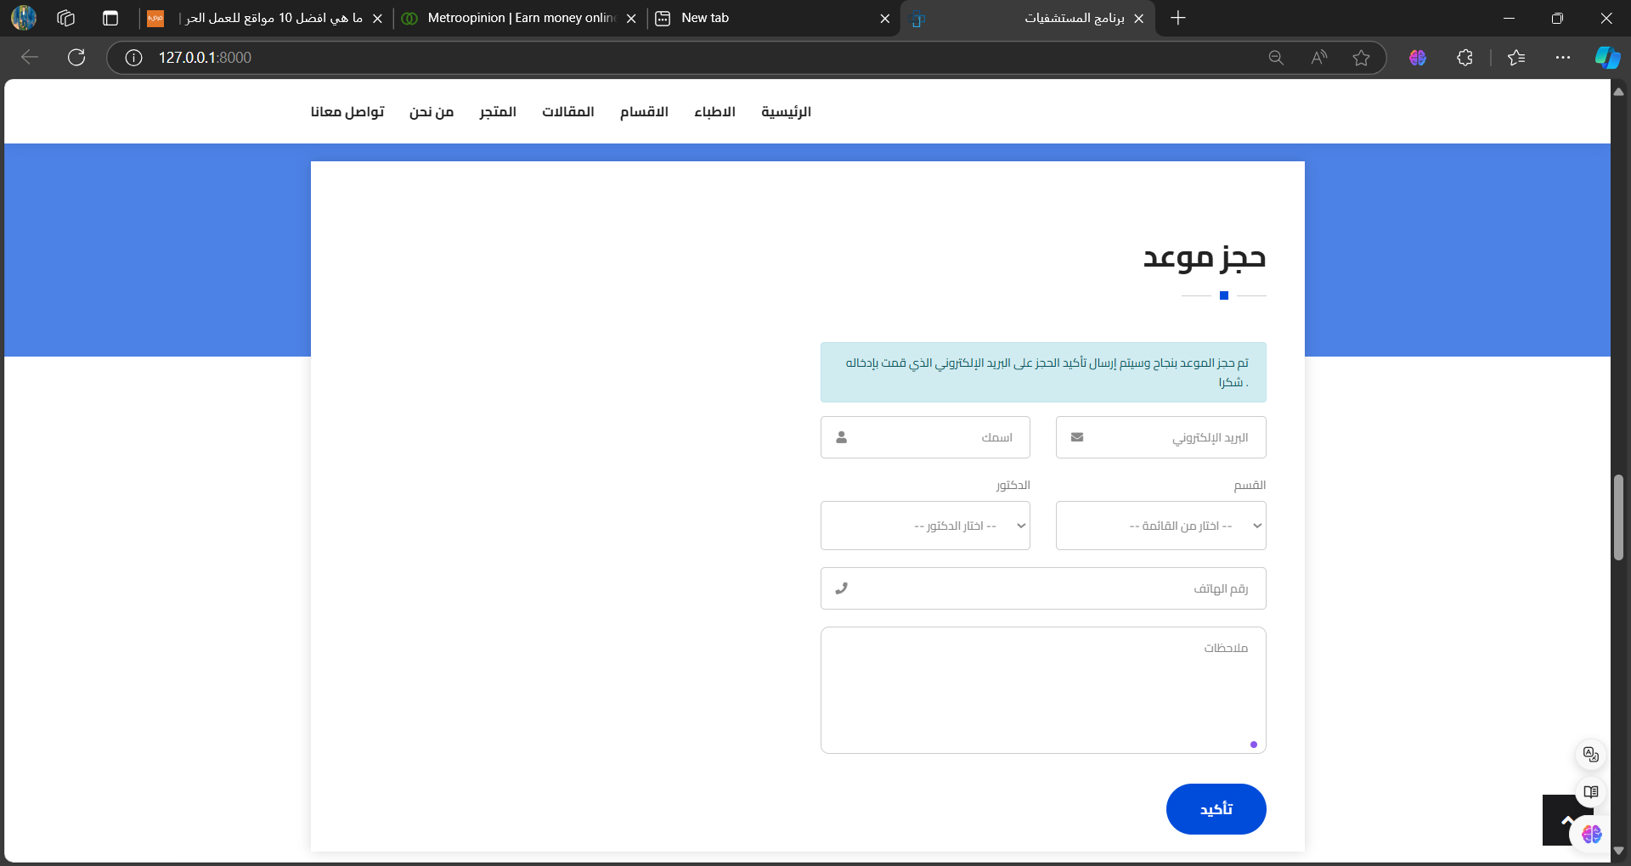
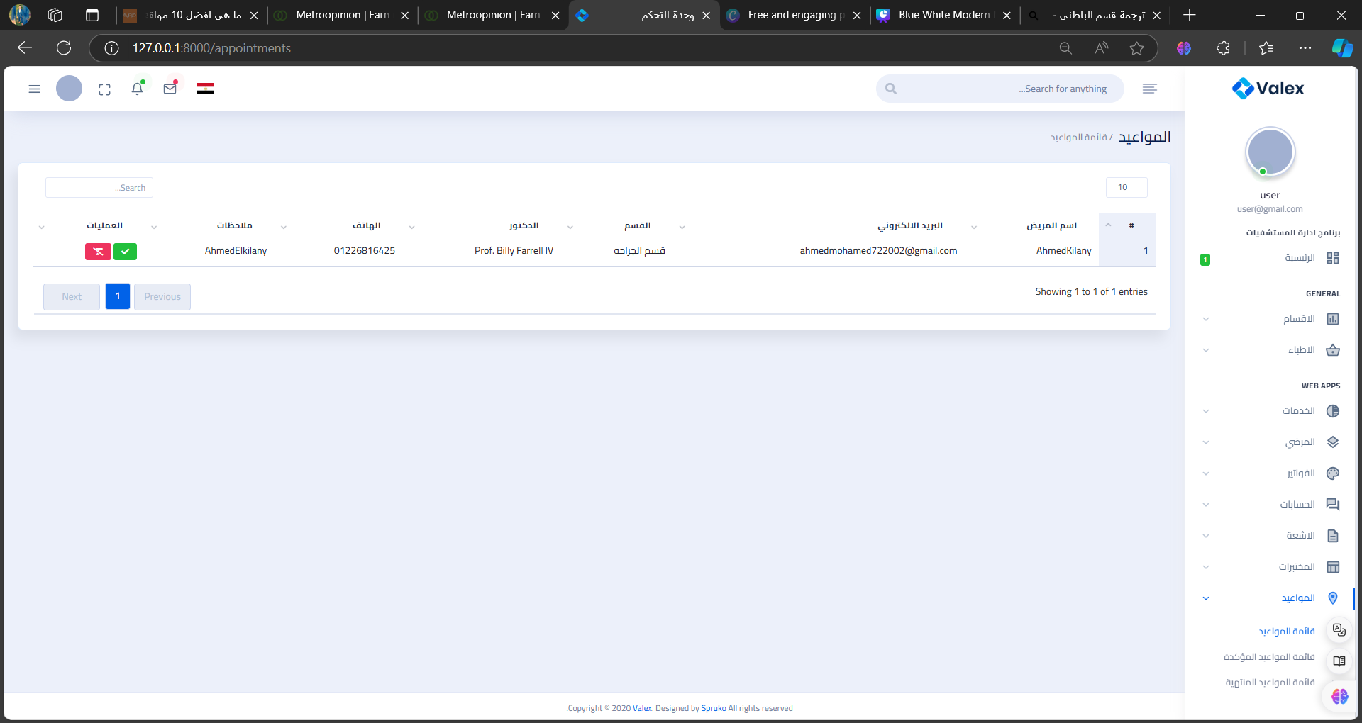
After click ok , the confirmation message will appear to you.
You can find appointments In appointments window in Dashboard

Slide 23
Thank
You

